Slide 1
Deep Learning Term Project
GAN-BERT: Generative Adversarial Learning for Robust Text Classification with a Bunch of Labeled Examples
Apoorv Badar
2019A7PS0060P

Slide 2
OBJECTIVE
State of the art results in NLP require a large amount of labelled data which is both time consuming and expensive.
Quality of BERT fine-tuned with less than 200 labelled instances shows significant drops, especially in classification tasks involving many categories.
However, unlabelled data characterizing the task can be obtained both economically and easily.
This unlabelled data can be used to improve the generalization capability using semi-supervised methods.
Semi-Supervised Generative Adversarial Networks (SS-GANs).

Slide 3
GAN-BERT, reduces the requirement for annotated examples: even with less than 200 annotated examples it is possible to obtain results comparable with a fully supervised setting,thus making it an excellent method for low resource settings .

Slide 4
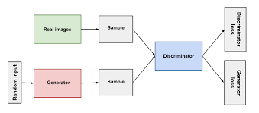
Generative Adversarial Networks (GAN)
A framework for generative models via the training of two adversaries - the generator(G) and the discriminator(D).The generator tries to model the data distribution and generate realistic data whereas the discriminator learns to distinguish between real and fake data.
The training procedure for G is to maximize the probability of D making a mistake.This framework corresponds to a minimax two-player game.
Notes:
The goal is to have the two networks achieve equilibrium, at which point the generator is creating almost realistic data and the discriminator is left with a 50% chance of discriminating correctly.

Slide 5
Semi-Supervised GANs
Semi-Supervised Learning- Combination of labelled and unlabelled data.
In SS-GANs ,in addition to the k classification categories,the discriminator also assigns a category to each example whether it was automatically generated i.e fake or real.Thus, the discriminator is trained over a (k + 1)-class objective: “true” examples are classified in one of the target (1 ... k) classes, while the generated samples are classified into the k + 1 class.

Slide 6
This enables learning from the unlabelled data as well.
The labeled material is used to train the discriminator on the classification task.
The the unlabeled examples (as well as the ones automatically generated) improve the discriminator’s inner representations.

Slide 7
Why adversarial learning is beneficial
With the improvement in the generator’s ability to model the real data distribution,the discriminator also improves in capturing the finer inner representations of the data to help it distinguish between the real and the fake.
This improvement in feature extraction can then be extended for further tasks such as classification.

Slide 8
Related Work
Prior to this paper,the use of SS-GANs perspective in NLP has been investigated only by (Croce et al,2019) with the Kernel Based GAN.While the S-GAN improves the quality of the Multi-layered perceptron used in the architecture,however,it only operated in a precomputed embedding space from by approximating a kernel function (corresponding to a dot product in the space).It does not affect the input representation, which is statically derived by the kernel space approximation.
Only marginally investigated the GAN perspective for NLP tasks.
Notes:
Kernelization:Simiarity function that corresponds to an inner product is some expanded feature space.(Linear classifier rely on dot product between vectors).Simplification enabling prediction without phi,just using the base features.using SS-GANs In the present work, all the parameters of the network are instead considered during the training process, in line with the SS
GAN approaches.

Slide 9
METHODOLOGY
BERT - a deep model trained on the large corpora of text with tasks on masked language modelling and next sentence prediction.
Building block of BERT -Attention i.e. learn contextual relation between words in a text by looking at how much to focus on different words in the text to gain a better representation of the current word.
Given an input sentence s = (t₁ ... t_{n}) ,BERT produces in output n + 2 vector representations in R^{d}, i.e. (h_{CLS}, h_{t1} … h_{tn}; h_{SEP} )
h_{CLS} is the encoding of the [CLS] token added at the beginning of the text.Since it has no meaning of its own,it captures the information on all the other sub-words and is hence used as a sentence level embedding for classification tasks.

Slide 10
GAN-BERT
Extend BERT by using SS-GANs for the fine-tuning stage.
Use an already pre-trained BERT model and adapt the fine-tuning by adding two components: i) task-specific layers, as in the usual BERT fine-tuning; ii) SS-GAN layers to enable semi-supervised learning.This is done by introducing i) a discriminator D for classifying examples, and ii) a generator(G) acting adversarially.
G : Multi Layer Perceptron with input as a100-dimensional noise vector drawn from N(μ,𝛔²)nd produces in output a vector h^{fake} ϶ R^{d}.

Slide 11
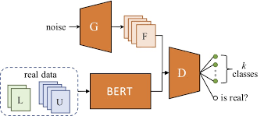
D:Another MLP that receives an input vector h* ϶ R^{d} where h* can be either h^{fake} produced by the generator or h^{CLS} for unlabeled or labeled examples from the real distribution. The last layer of D is a softmax-activated layer,followed by a softmax layer for classification.
GAN-BERT Architecture

Slide 12
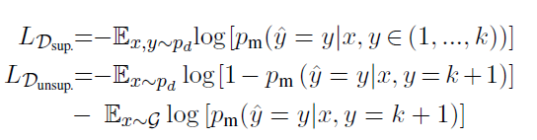
LOSS FUNCTION
Optimize two competing losses L_{D} and L_{G} .
The loss function of D is defined as L_{D} = L_{D sup.} + L_{D unsup.} where:
Notes:
probability provided by the model m that a generic example x is associated with the fake class and pm(^y = yjx; y 2 (1; :::; k)) that x is considered thus belonging to one of the target classes.
Unsup -> unlabeled data being classified as as fake ,as well as not recognizing fake ones.

Slide 13


The generator loss is L_{G} = L_{G feature} _{matching} + L_{G unsup.} where :
Notes:
the average example generated in a batch by G should be similar to the real prototypical one. Formally, f(x) denotes the activation on an intermediate layer of D

Slide 14
During backpropagation,
Labelled data :used in training the discriminator on the classification task.
Unlabelled data: considered in L_{D unsup.} when they are erroneously classified as fake.
Fake Data:Contributes to both L_{D} and L_{G} .

Slide 15
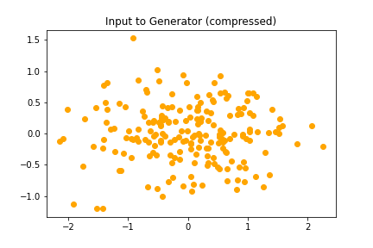
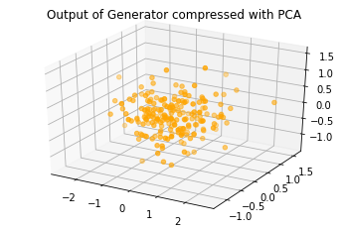
Generated Fake Data
Given a 100 dimensional noise vector drawn from the normal distribution N(0,1) ,the generator maps to a 768 dimensional output vector equivalent to the embedding dimension of the BERT,which is then used as a fake example in the architecture.

Slide 16
Results
Observed the impact of GAN-BERT for text classification tasks such as Topic Classification over the 20 News Group (20N) , Question Classification (QC) on the UIUC dataset , Sentiment Analysis over the SST-5 dataset (Socher et al., 2013) and a sentence pair task, i.e., over the MNLI dataset.
Using below 10% of the dataset, GAN-BERT is able to obtain a much better accuracy than the base BERT model,especially for classification tasks involving a larger number of categories.

Slide 17
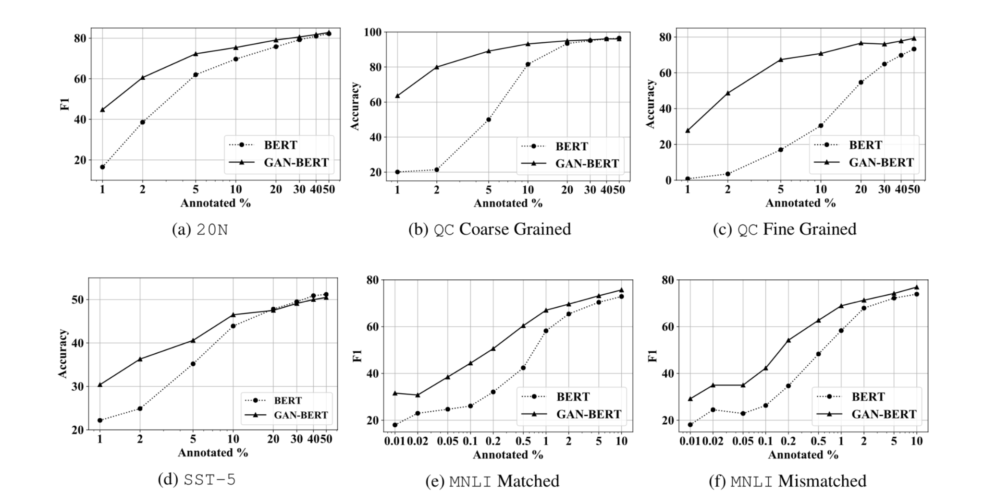

Slide 18
CONCLUSION
Extended the limit of transformer based architecture in low resource settings.
Does so without introducing any additional cost at the time of inference since only the discriminator i.e the classifier network is used for the same.
First investigation paving the way for further extensions ,adopting other architectures such as GPT-2 and other tasks such as Question Answering.
Notes:
share a single architecture for classification and discrimination. However, this may require a model to converge to a separate data distribution for each task, which may reduce overall performance. While progress in semi-supervised learning has been made, less addressed are small-scale, fully-supervised tasks where even unlabeled data is unavailable and unattainable. We therefore, propose a novel GAN model namely External Classifier GAN (EC-GAN), that utilizes GANs and semi-supervised algorithms to improve classification in fully-supervised regimes. Our method leverages a GAN to generate artificial data used to supplement supervised classification. More specifically, we attach an external classifier, hence the name EC-GAN, to the GAN's generator, as opposed to sharing an architecture with the discriminator. Our experiments demonstrate that EC-GAN's performance is comparable to the shared architecture method, far superior to the standard data augmentation and regularization-based approach, and effective on a small, realistic dataset.
->https://github.com/ayaanzhaque/EC-GAN

Slide 19
Research Question based on the paper
Q) Random noise distributions are hard to control, and usually lead to weak results. Over the past few years, various self supervised methods have been developed to replace the "random noise" approach, and have shown much better performance. How would you develop a novel pipeline that eliminates the use of random noise, and how(and why) it would improve the performance. Remember you have only a few labeled examples, so you should think on the lines of preventing overfitting as well.

Slide 20
Improving the Random Noise Approach*
Instead of sampling from a normal distribution for input to the generator,a Decoder-Encoder architecture can be used to fit a noise distribution which carries the information of the text dataset which is then passed to the generator of the adversarial network.
The vectors sampled from a bare Gaussian distribution include a number of noise points which are not suitable for generation. So, if we use output of the decoder-encoder ,noise z₀ as the input of the generator , we can eliminate the unreasonable noise points and improve the quality of generated image.
*Inspired from Generative Adversarial Networks with Decoder-Encoder Output Noise Zhong et al ,CVPR 2018

Slide 21
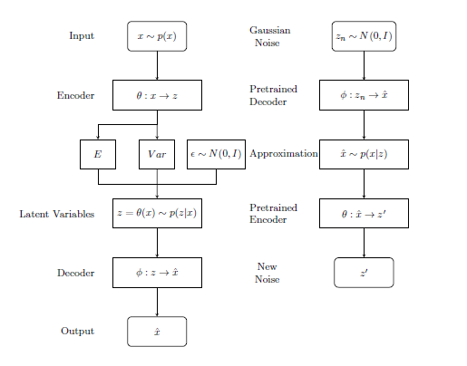
Conventional Variational AutoEncoders (VAE) vs the proposed encoder-decoder architecture,

Slide 22

First ,we train a VAE architecture on a text corpora and then swap the trained encoder and decoder to use for the Decoder-Encoder (DE) architecture.
A gaussian noise vector N(0,1) is first sent to the decoder and flows through the whole architecture.The decoded output is then passed to the encoder.Since the dimension of the input of the decoder and the output of the encoder are the same, the Decoder-Encoder structure doesn’t change the dimension of the noise vectors but makes them carry the information of the text corpora.
It transforms a Gaussian noise to a posterior one which is then used as input to the generator.
Notes:
the latent space of the structure contains information of the dataset. Hence, the input vectors of the generator are limited to a prior distribution which is more compact than the Gaussian distribution.builds a bridge between the gap of two seemingly irrelative pictures and makes a reasonable interpolation. This capability can help us generate different face images according to the given input vectors.

Slide 23
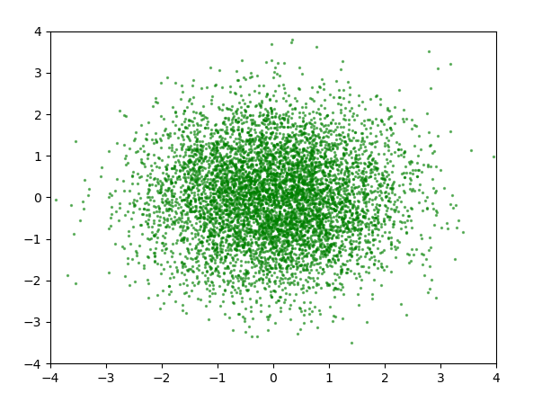
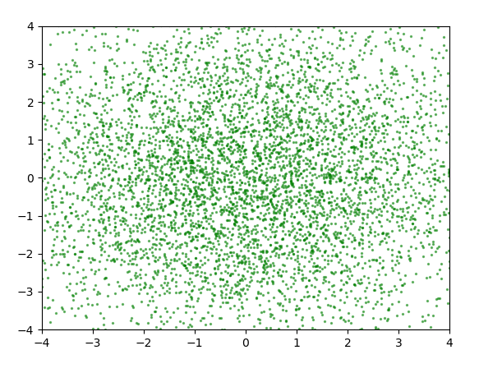
Input random noise from the normal distribution
Output noise obtained from the decoder-encoder architecture.
Notes:
the original noise ,the Gaussian distribution and gathers on the origin of coordinates. But the posterior ones are much more sparse. So the Decoder-Encoder structure could change the distribution form of the input vectors.

Slide 24
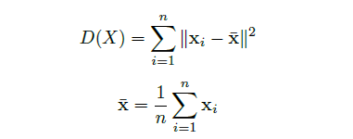
Preventing overfitting,ensuring diversity
To avoid overfitting as well as measure the capability of the generator to generate diverse outputs,a criterion diversity D was proposed in the mentioned paper and DE-GANs were found to be better than DCGANs but had a lower score than W-GANs,possibly due to pre-training of the VAE on the dataset.
rdd = D(X)/D_{dataset}
Diversity Score
Relative Diversity Score
Notes:
As opposed to fixed typewritten digit images, human’s written digits are metamorphic from time to time. A single numeral figure could be produced with thousands of patterns. So an important metric on the generalization ability of these generative models is the diversity of the digits generated by them.

Slide 25


